Slide 1
YAPTIKLARIM:
I converted the floating-point modules of the Packet Detect, Coarse CFO Estimation, and Coarse CFO Correction blocks to fixed-point.
I compared and tested the accuracy of fixed-point and floating-point modules using these modules.

Slide 2
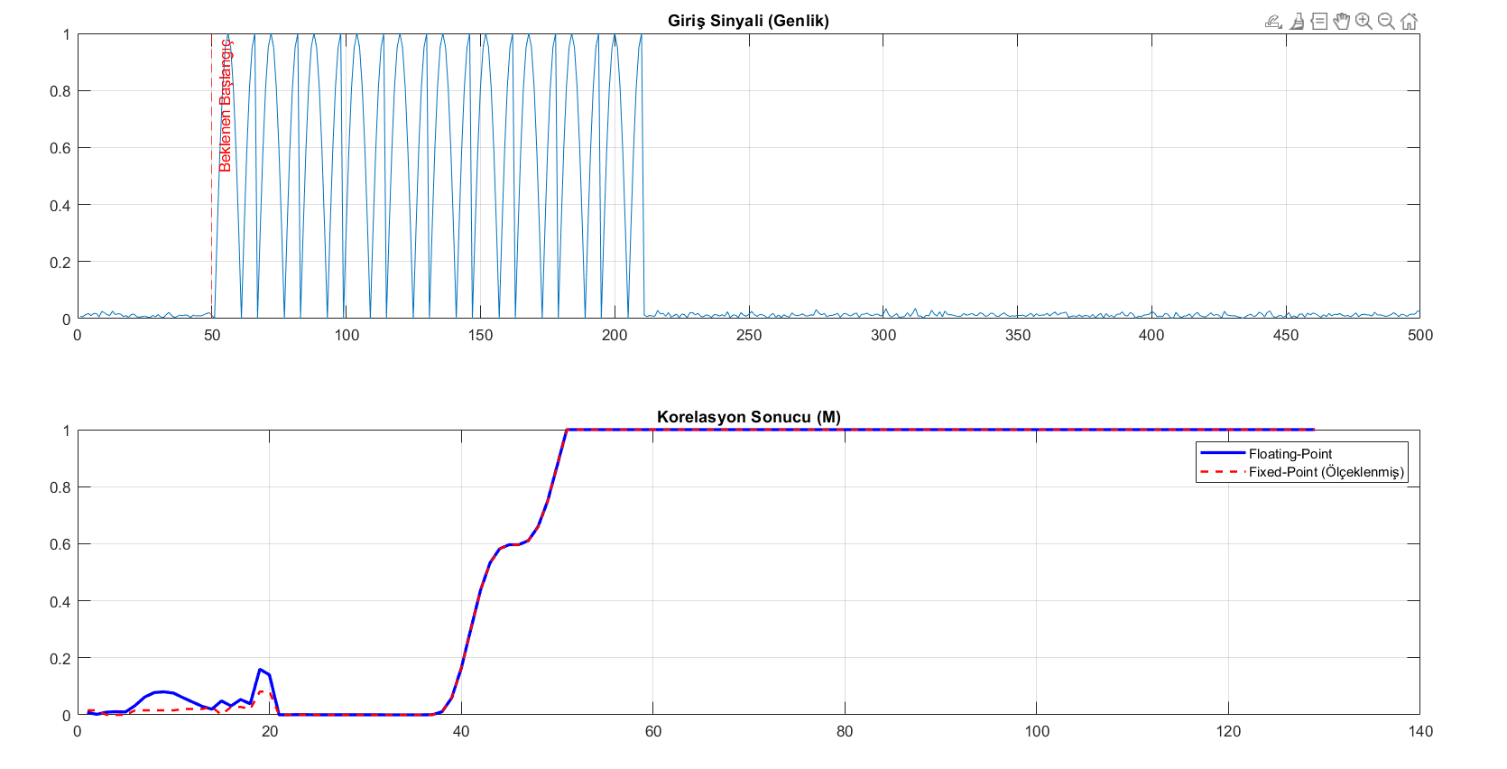
PACKET DETECT Fix vs Float Results

Slide 3
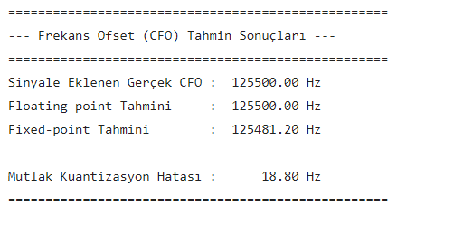
Coarse CFO Estimator Fix vs Float Results

Slide 4
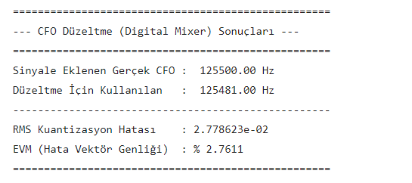
Coarse CFO Correction Fix vs Float Results​

Slide 5
